Slide 1
Adopting Neptune.AI at ALCF
Riccardo Balin
Postdoctoral Appointee
Argonne National Laboratory, LCF
May 19th, 2022

Slide 2
Outline
Introduction
Account options and payment
Installation of client library
Example of Logging a Training Run
Comparison to Weights & Biases

Slide 3
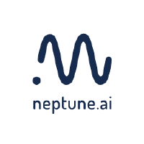
Introduction to Neptune.AI
Neptune is an open-source metadata store for MLOps
Provides users and teams the ability to log, store, display, organize, compare an query all model-building metadata in a single place
Website: https://neptune.ai/
Documentation: https://docs.neptune.ai/
GitHub page: https://github.com/neptune-ai
Useful examples to get started: https://github.com/neptune-ai/examples

Slide 4
Introduction to Neptune.AI
General Features
Log and display ML metadata and training data
Code, config files and hyperparameters
Performance metrics and loss/accuracy curves
Hardware consumption and console log (stdout and stderr)
Model weights and model checkpoints (e.g., saved as a .pt file)
Any chart or visualization (e.g., plots produced with matplotlib)
Training data as an artifact (file path and hash)
Model registry for managing a model lifecycle
Compare experiments and models
Web UI allows autodiff of all metadata between runs
Monitor ML runs live from web UI
Query metadata from UI and programmatically
Integrates with most ML frameworks for automatic logging
Works as SaaS or with on-premise deployment (keep metadata local)

Slide 5
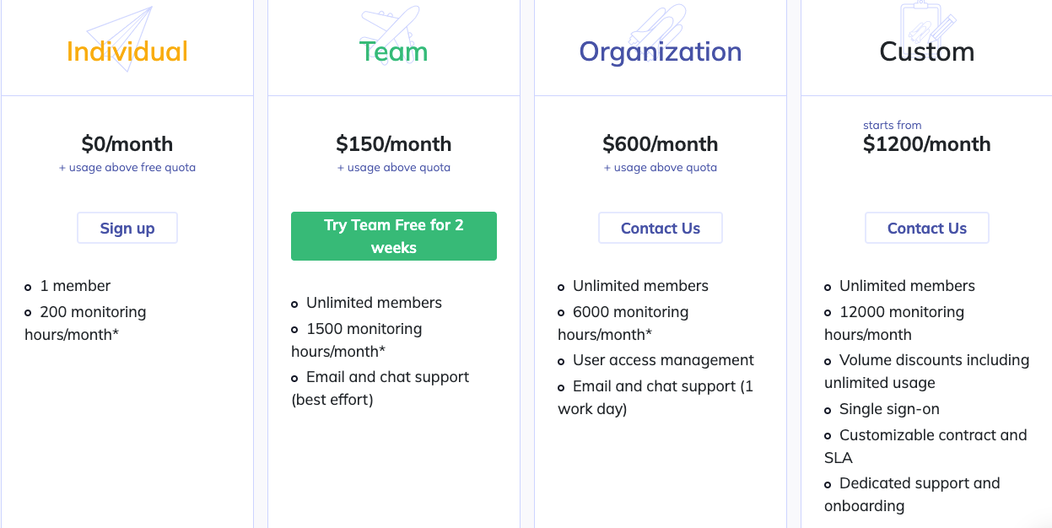
Account Options for Teams Using Neptune.AI

Slide 6
Account Options for Teams Using Neptune.AI
Notes
Can add storage and monitoring hours for a fee ($10 per 100 hours)
Unused monitoring hours roll over month-to-month, but get reset every year (for individual account at least)
Team plans offered for free (with larger base quotas) to academia, research and education groups, and non-profit organizations
Accounts are charged based on usage, NOT number of users or duration of user active account
Charged based on monitoring hours consumed by all users belonging to a team/organization
Add infinite users at very small additional cost if usage is negligible
Could be attractive option for ALCF, average cost of adding users to account is likely small
Monitoring hours: hours spent actively logging metadata with Neptune API (more details in backup slide)

Slide 7
Installation of Client Library
Using Pip on ThetaGPU
Install Neptune client simply with pip install neptune-client
Can load my env with conda activate /grand/datascience/balin/NeptuneAI/testPipInstall/env/nept
Neptune also allows an on-premise deployment
Metadata is stored on local machines or private cloud
Can be deployed as Kubernetes Cluster or VM running Kubernetes under the hood
There is a free 30 day on-premise trial
More information and instructions at https://docs.neptune.ai/administration/on-premises-deployment

Slide 8
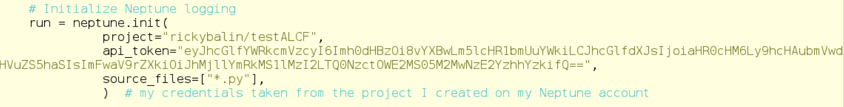
Example Training Run
Source code for example found at https://github.com/rickybalin/ALCF/tree/main/MLOps/Neptune.AI
Simple serial training of 1 layer ANN on random data
Modifying code to log metadata with Neptune API is simple
Import Neptune module
Initialize Neptune logging, and include source code files (API token can be environment variable)

Slide 9
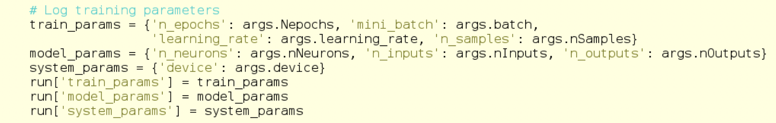

Example Training Run
Modifying code to log metadata with Neptune API is simple
Log some training hyperparameters
Pass Neptune run object to training function
Log loss and accuracy at each epoch

Slide 10
Example Training Run
Modifying code to log metadata with Neptune API is simple
Upload model checkpoint
Stop Neptune logging at end of program
Log training data as an artefact (I did not do this since I generated training data within program)

Slide 11
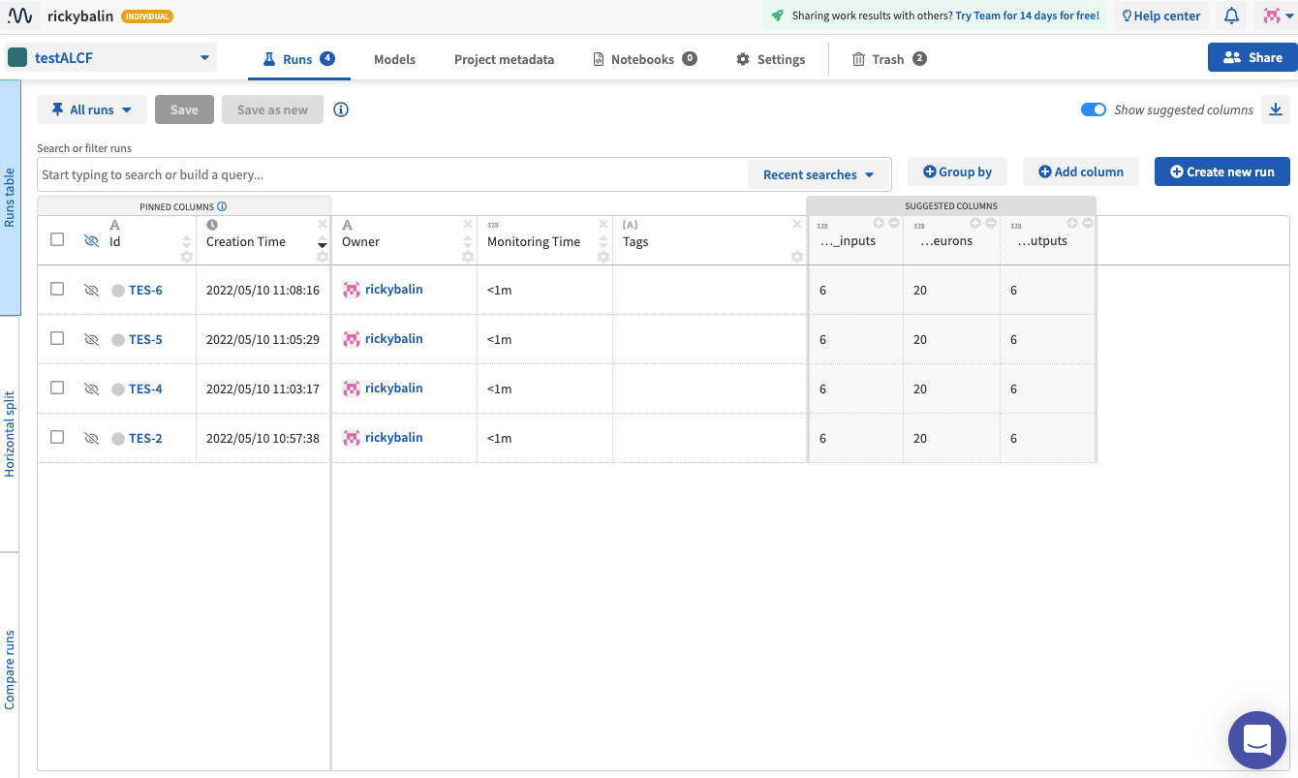
Example Training Run
Visualize and compare experiments on web UI

Slide 12
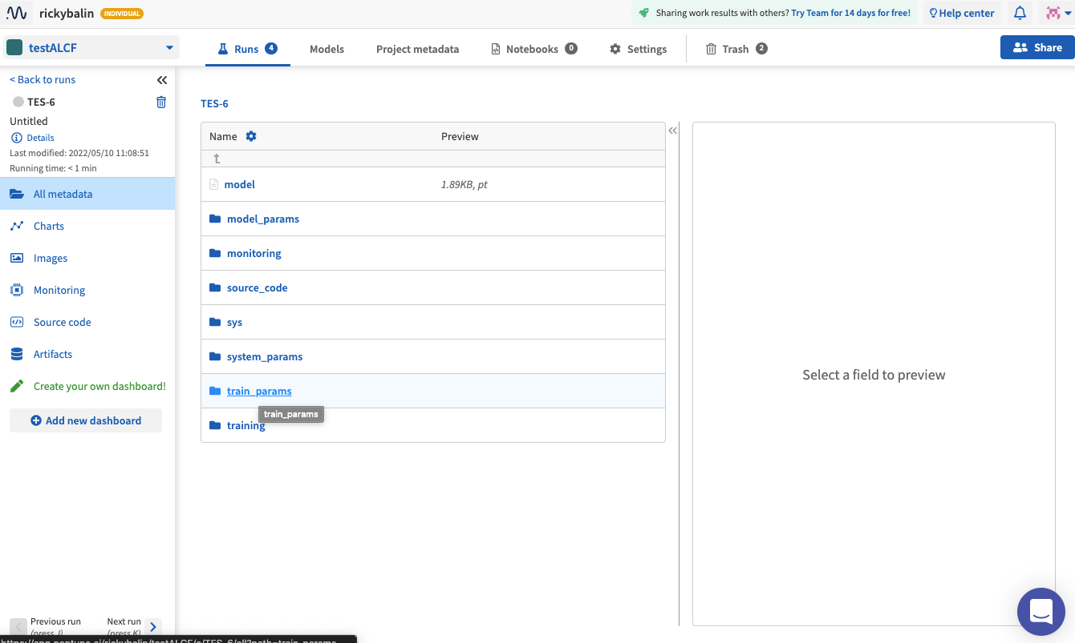
Example Training Run
Click on run name to visualize metadata logged

Slide 13
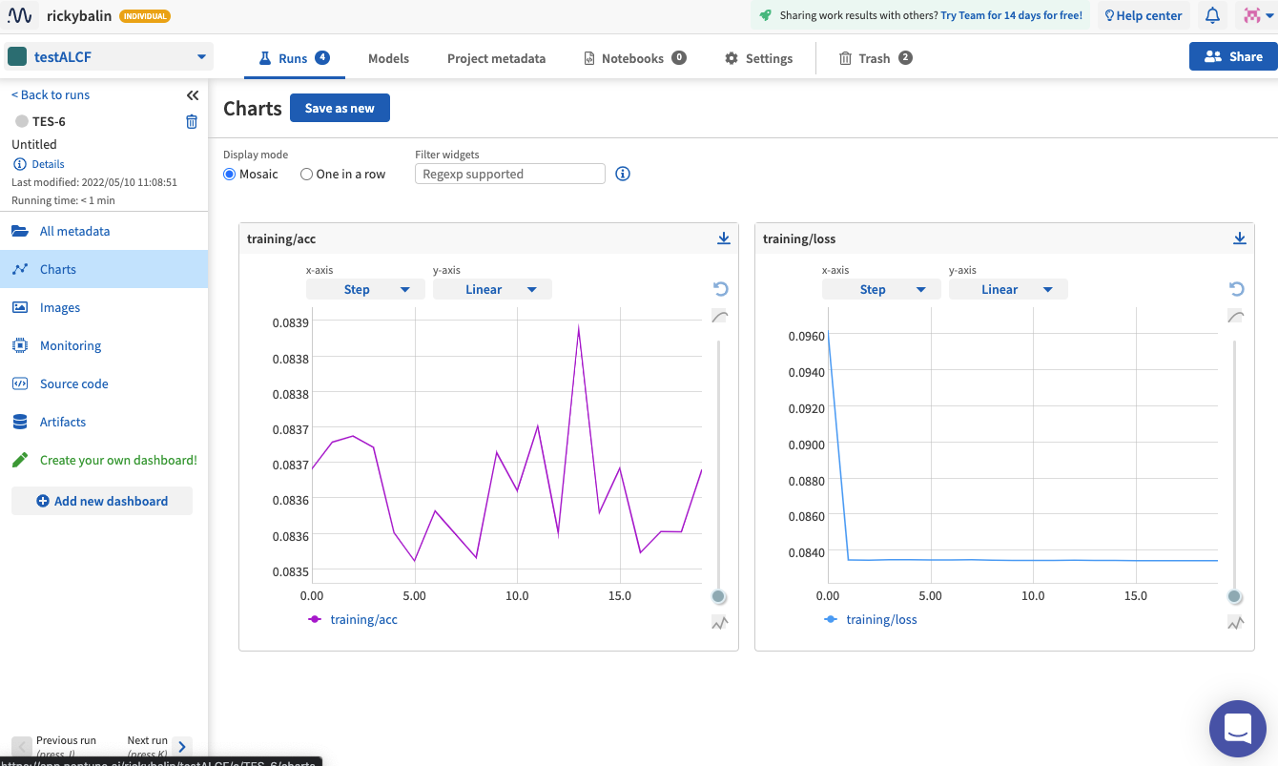
Example Training Run
Click on run name to visualize metadata logged

Slide 14
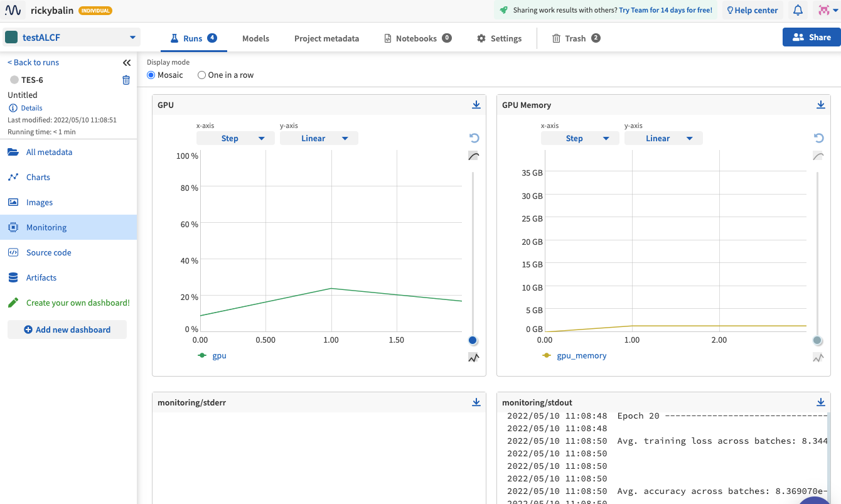
Example Training Run
Click on run name to visualize metadata logged

Slide 15
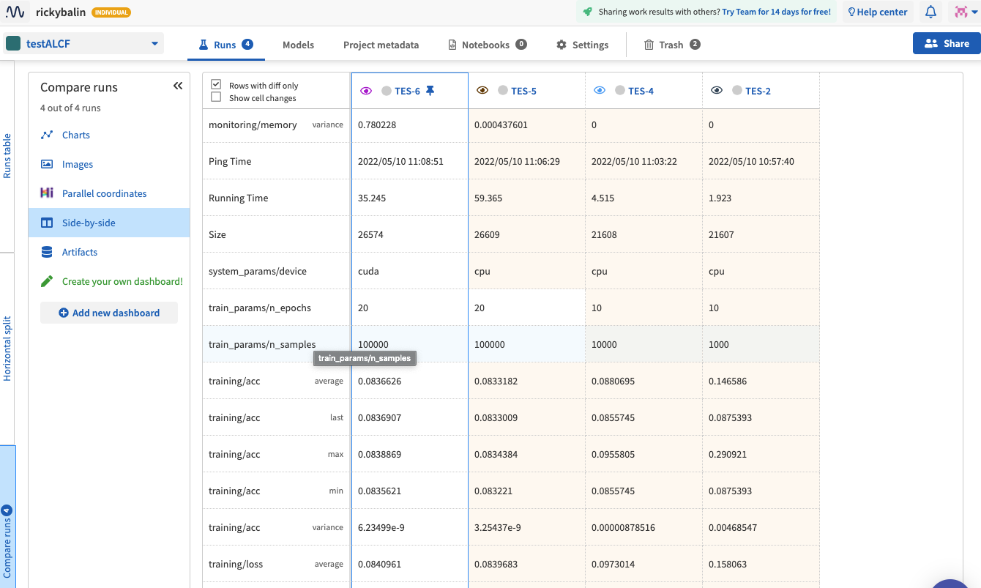
Example Training Run
Select what runs to compare clicking on the eye next to the run name

Slide 16
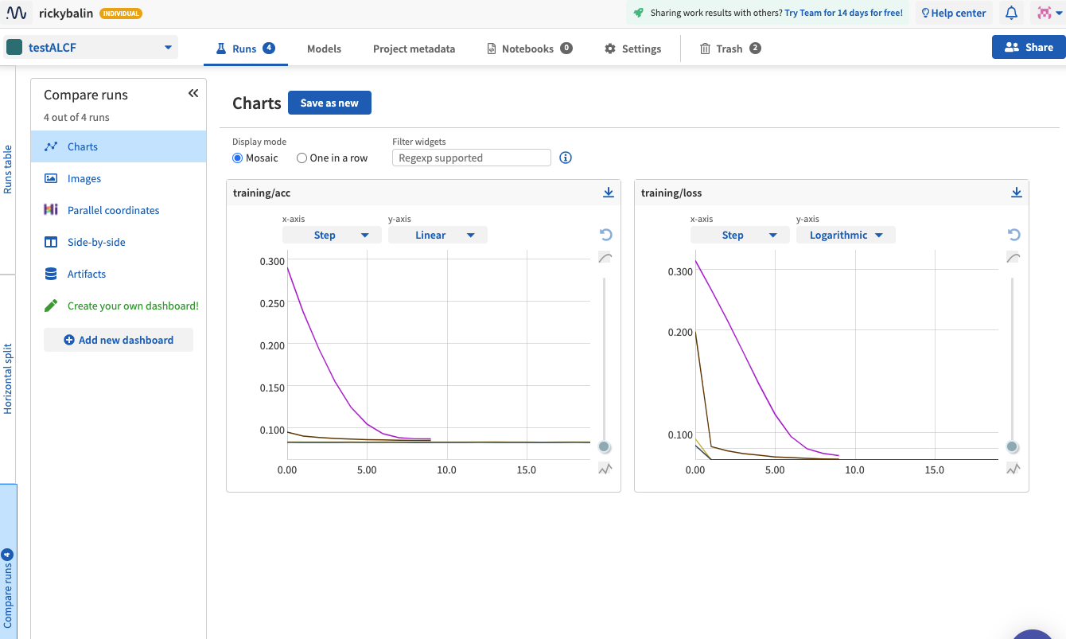
Example Training Run
Select what runs to compare clicking on the eye next to the run name

Slide 17
Comparison with W&B
Notable similarities
Allow on-premise deployment
Minimal changes to code for logging
Distributed training support
Web UI to navigate through experiments and metadata
Neither interacts with a job scheduler (Cobalt or PBS)
Notable differences
Neptune has limited TensorBoard support
Neptune does not have interactive project level reports
Neptune has more features to organize and search experiment metadata

Slide 18
Backup Slides

Slide 19
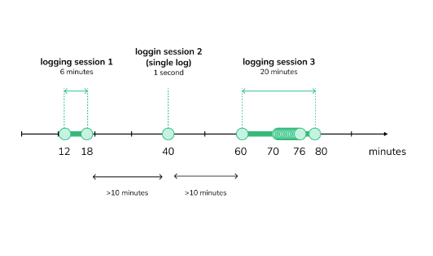
Charging Monitoring Hours
Monitoring hours are the time spent actually logging metadata via the Neptune API
Browsing, exploring, querying the metadata with the web UI or programmatically does not accumulate monitoring hours
If logging instances are separated > 10 minutes in clock time, instances logged individually with 1 sec cost
If logging instances are separated < 10 minutes in clock time, logging time is the entire between two instances
Within first and last logging instance separated < 10 minutes, can log infinitely many times at no additional cost

Slide 20
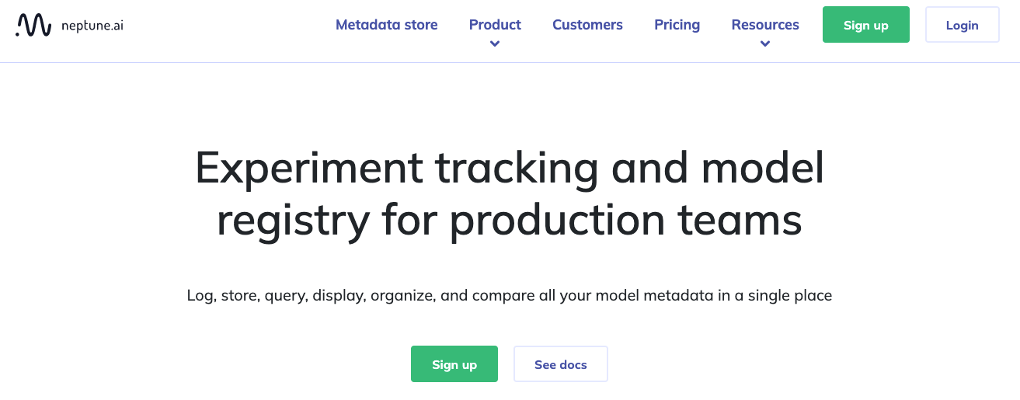
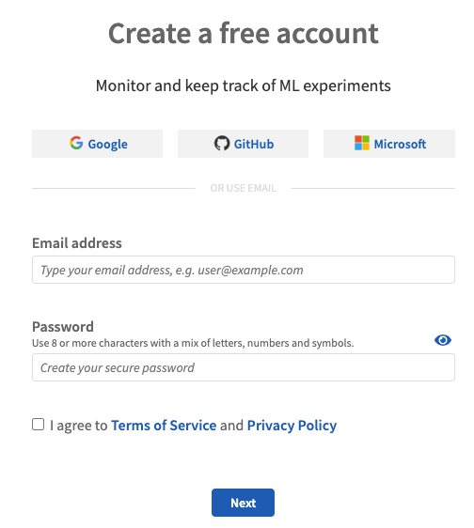
Signing Up to Neptune.AI
Click Sign up button on home page
Select how to sign up (I chose GitHub)
Select what type of account (individual or team)
Answer a few questions and you’re done!

Slide 21
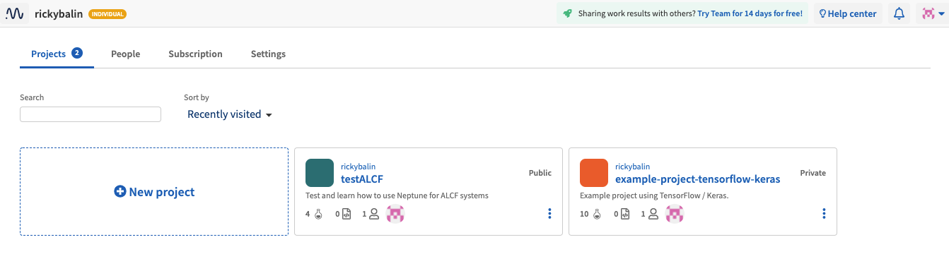
Signing Up to Neptune.AI
Logging in gets to to your home space in the user interface

